Slide 1
Chapter 25 Introduction to Software Testing
Focus:
Principles of Testing and Unit Testing

Slide 2
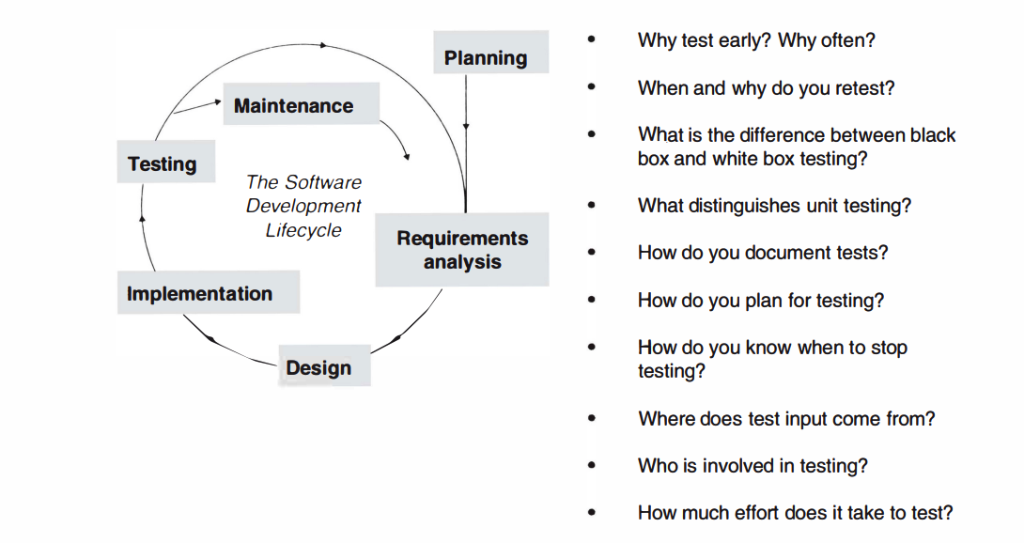

Slide 3
Software Testing Overview
Software testing is a validation process.
Purpose: Detect as many defects as possible, focusing on severity.
Key Insight: Testing reveals defects but cannot confirm their absence.

Slide 4
Why Test Early and Often?
'Test Early': Detect defects close to their introduction for easier correction.
'Test Often': Re-test after every addition or change to ensure integrity.

Slide 5
Agile Methodology Connection
Agile emphasizes continuous testing as part of development.
Goal: Avoid regression and ensure growth without erasure*.
* A goal of modern development methods, and especially of agile methods, is for the application under development to grow only-in other words, not to require any other kind of alteration such as erasures. Accomplishing this (which is not always easy) means that existing tests continue to apply as new elements are developed.

Slide 6
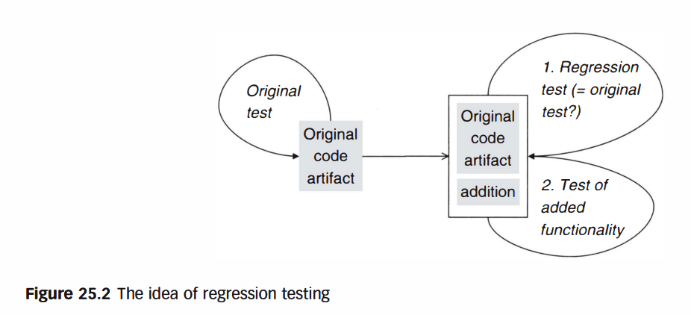
Regression Testing
Definition: Retesting software to confirm no new defects after changes.
Purpose: Ensure functionality remains intact after updates.

Slide 7
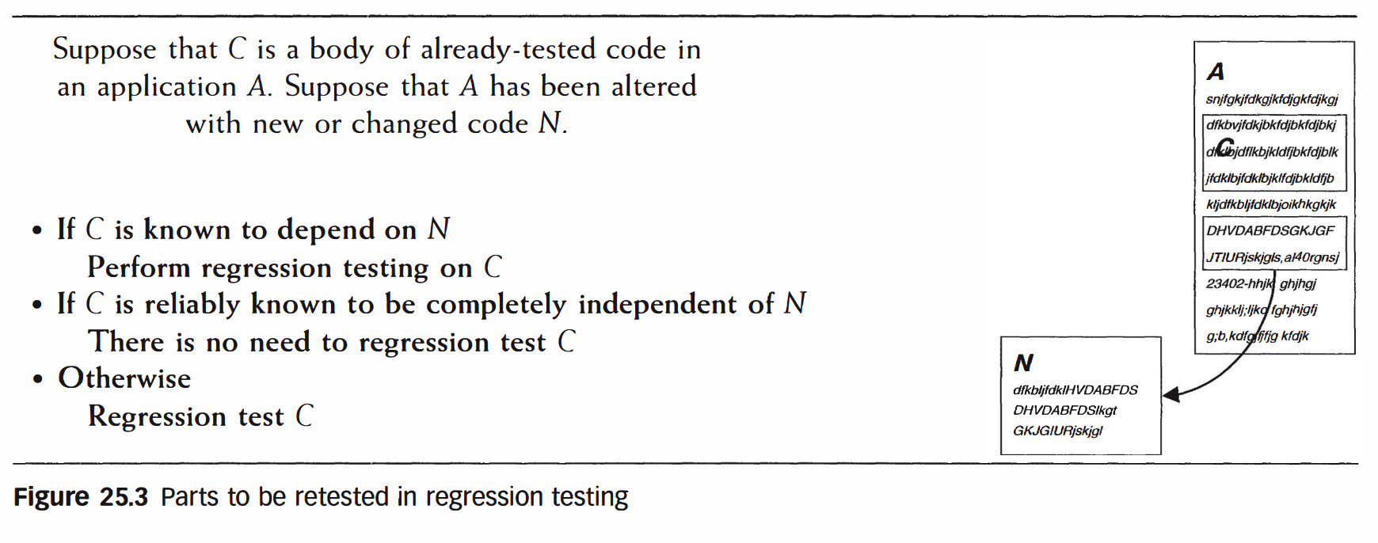
Regression Testing Example
Adding functionality to DVD rental software may alter due date handling.
Solution: Regression tests verify no unintended changes occurred.

Slide 8
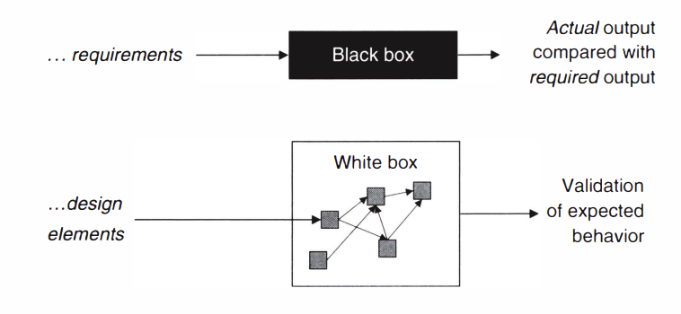
Testing Methodologies
Black Box Testing: Based on application requirements, no internal knowledge.
White Box Testing: Leverages design and implementation insights.

Slide 9
Unit Testing Overview
Definition: Testing individual components (methods, classes).
Goal: Detect defects early for cost-effective resolution.

Slide 10
Importance of Unit Testing
Defects undetected at the unit level can multiply in cost during later phases. i.e., want to catch issues at the smallest level before they escalate.
Example: Isolating defects early ensures foundational reliability.
Regression Prevention: Helps ensure new changes do not break existing functionality.

Slide 11
Unit Testing and Modular Design
Object-oriented designs benefit from modular testing.
Classes and methods are natural units for isolated validation.
A “unit” typically refers to a small function, method, or class.
The goal is to ensure that each unit behaves as expected under various conditions.

Slide 12
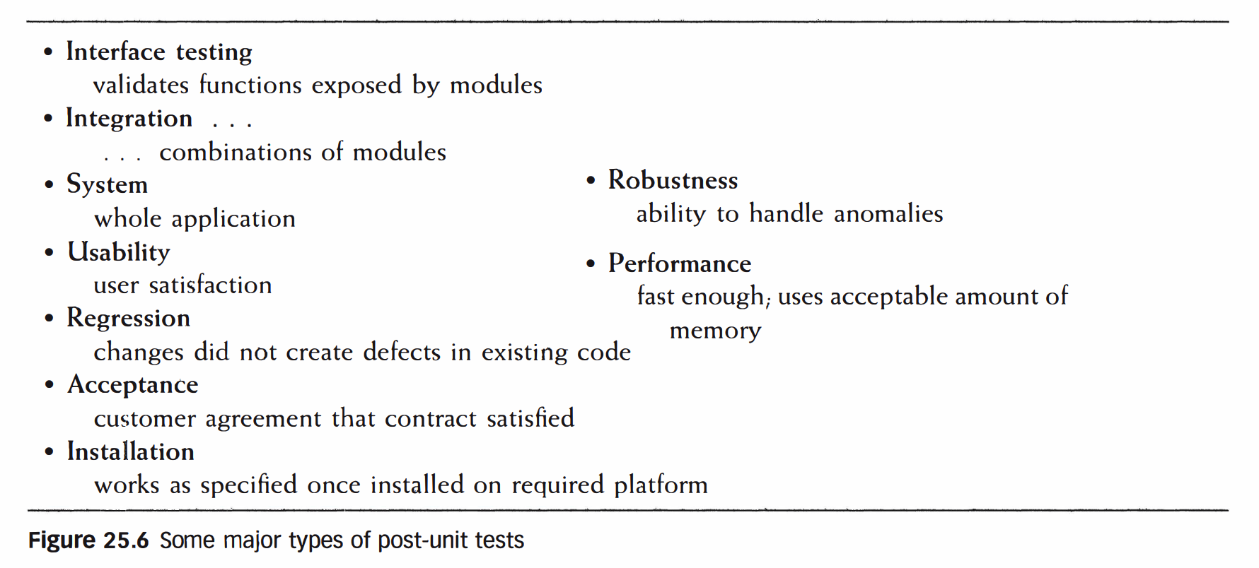
Post-Unit Testing Overview
Focuses on the integrated system beyond individual components.
Includes usability, performance, and regression testing.

Slide 13
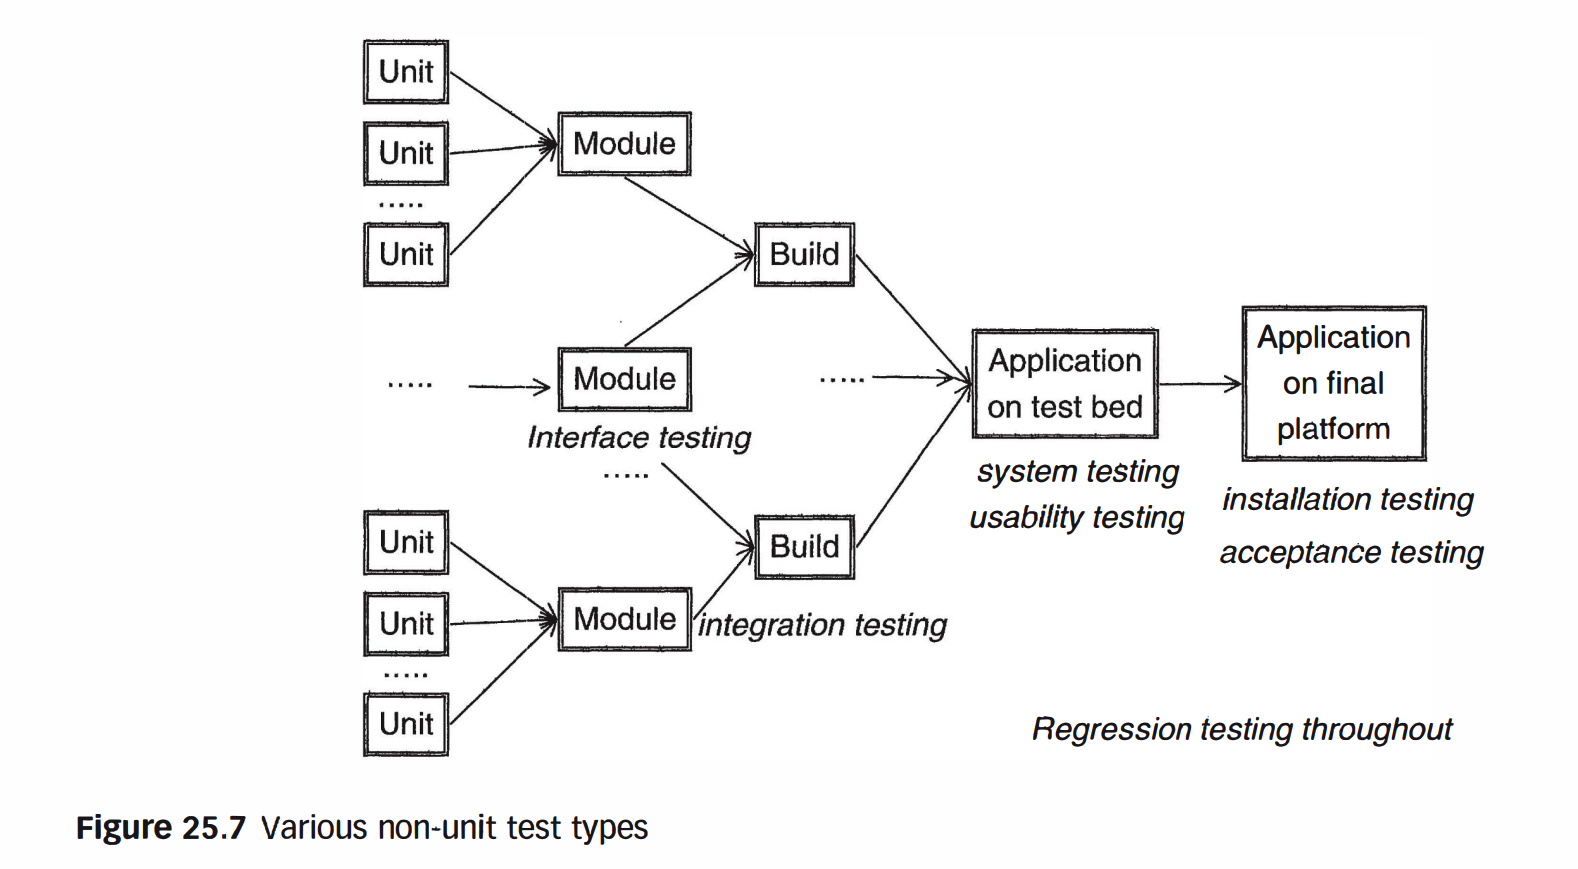
Post-Unit Testing Overview
Focuses on the integrated system beyond individual components.
Includes usability, performance, and regression testing.

Slide 14
Testing Objectives
Detect defects as early as possible.
Ensure each software component meets its intended purpose.

Slide 15
Documenting Tests
Maintain records of test procedures, input data, and results.
Reuse documentation for future testing cycles.

Slide 16
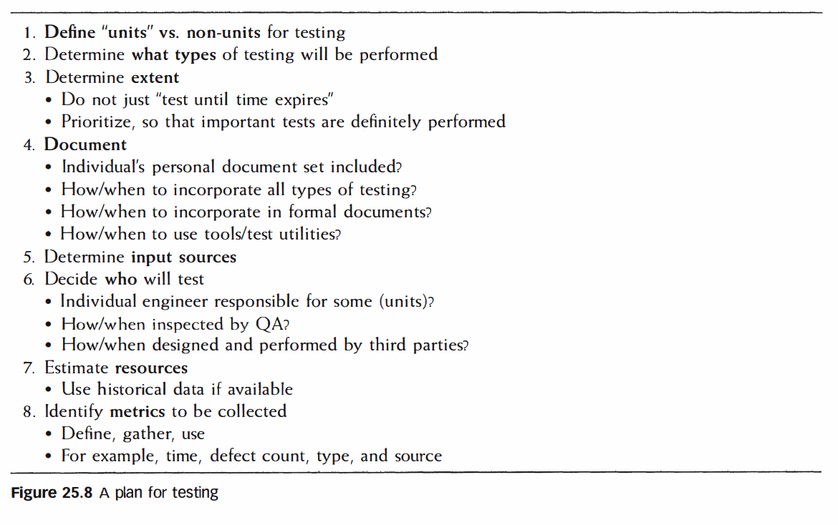
Planning Tests
Define test objectives and scope.
Prioritize critical functions for thorough validation.

Slide 17
Unit Test Execution
Leverage test utilities like Junit, PyUnit for consistent execution.
Automate repetitive tasks to improve efficiency.

Slide 18
Common Unit Testing Challenges
Overlooking edge cases.
Ensuring complete test coverage.
Repeatability of tests: produce the same results every time they are run
Automation: Unit tests should be automated and documented as a part of the development process.

Slide 19
Test Input Sources
Domain-specific data examples.
Historical outputs from prior versions of the application.

Slide 20
Best Practices for Unit Testing
Write tests as you develop the code (Test-Driven Development, or TDD).
Keep tests isolated—don’t rely on external resources like databases or APIs.
Strive for complete code coverage, but focus on critical paths.
Run tests frequently during development.

Slide 21
Unit Testing Metrics
Metrics include defect count, defect types, and testing time.
Helps assess application state and forecast completion.

Slide 22
Summary of Principles
Test early, test often.
Unit testing ensures foundational reliability.
Effective planning and documentation are critical.
By writing effective and automated unit tests, you can catch bugs early, improve code stability, and simplify future development and refactoring.

Slide 23
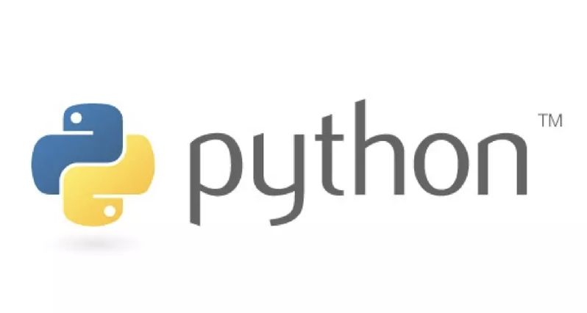

Introduction to PyUnit
PyUnit is the Python standard library module for unit testing, also known as the unittest module.
Inspired by JUnit (Java) and part of the xUnit family of testing frameworks.
Built into Python, so no external dependencies are required.
Provides a structured way to write and execute test cases.
Supports test automation, setup/teardown processes, and comprehensive reporting.

